Slide 1
Topic Modeling
Peitian Zhang
Renmin University of China
Currently @ MSRA Social Computing

Slide 2
Outline
Overview
Traditional Methods

Slide 3
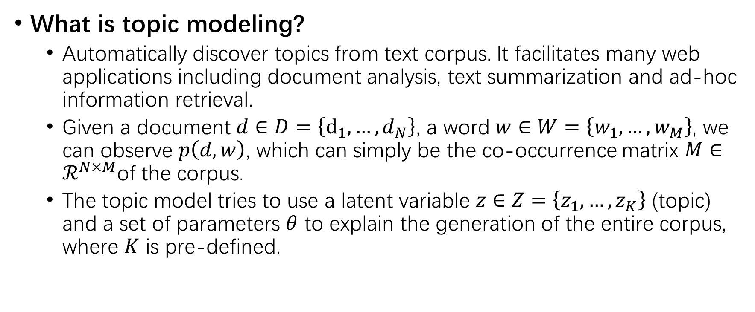
Overview
What is topic modeling?
Automatically discover topics from text corpus. It facilitates many web applications including document analysis, text summarization and ad-hoc information retrieval.
Given a document $d∈D=\left\{d_{1},…, d_{N}\right\}$, a word $w∈W=\left\{w_{1},…,w_{M}\right\}$, we can observe $p\left(d,w\right)$, which can simply be the co-occurrence matrix $M∈ℛ^{N×M}$of the corpus.
The topic model tries to use a latent variable $z∈Z=\left\{z_{1},…,z_{K}\right\}$ (topic) and a set of parameters $θ$ to explain the generation of the entire corpus, where $K$ is pre-defined.

Slide 4
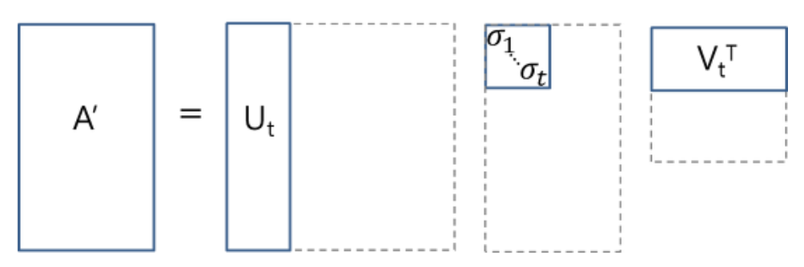
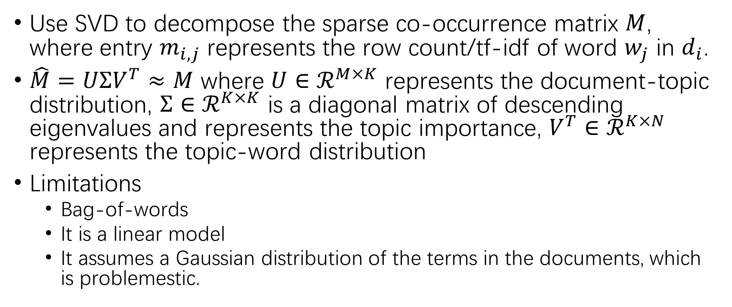
LSA
Use SVD to decompose the sparse co-occurrence matrix $M$, where entry $m_{i,j}$ represents the row count/tf-idf of word $w_{j}$ in $d_{i}$.
$\hat{M}=UΣV^{T}≈M$ where $U∈ℛ^{M×K}$ represents the document-topic distribution, $Σ∈ℛ^{K×K}$ is a diagonal matrix of descending eigenvalues and represents the topic importance, $V^{T}∈ℛ^{K×N}$ represents the topic-word distribution
Limitations
Bag-of-words
It is a linear model
It assumes a Gaussian distribution of the terms in the documents, which is problemestic.

Slide 5
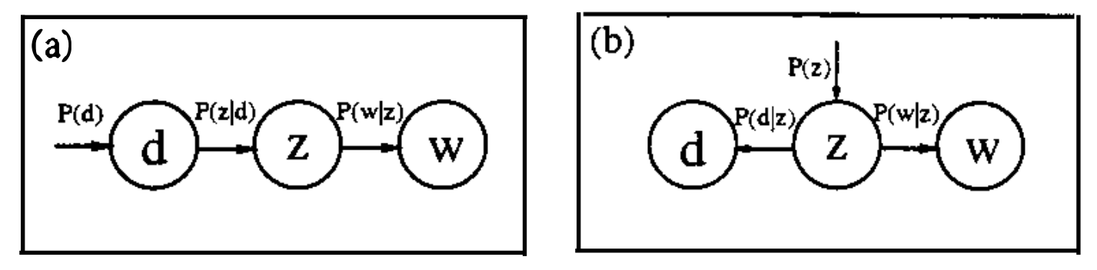
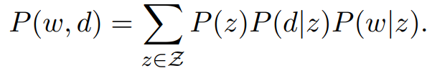
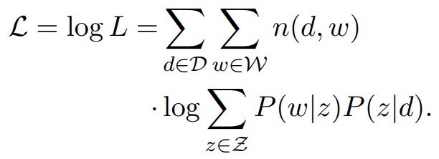
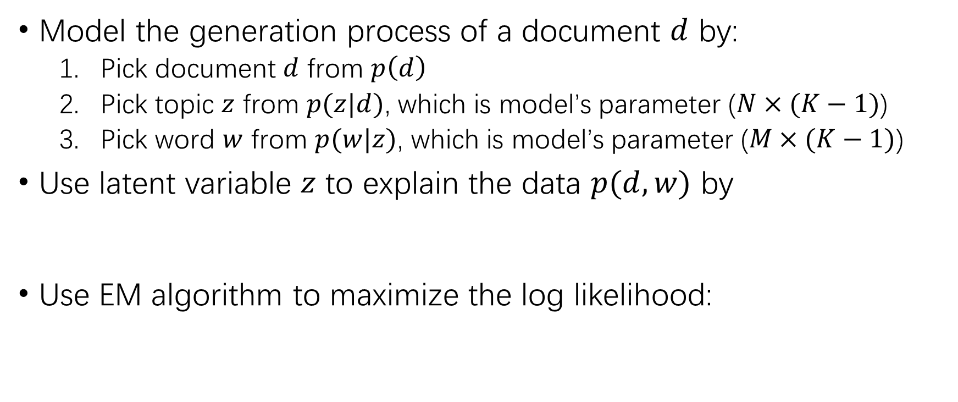
PLSA
Model the generation process of a document $d$ by:
Pick document $d$ from $p\left(d\right)$
Pick topic $z$ from $p(z|d)$, which is model’s parameter ($N×(K−1)$)
Pick word $w$ from $p(w|z)$, which is model’s parameter ($M×(K−1)$)
Use latent variable $z$ to explain the data $p(d,w)$ by
Use EM algorithm to maximize the log likelihood:

Slide 6
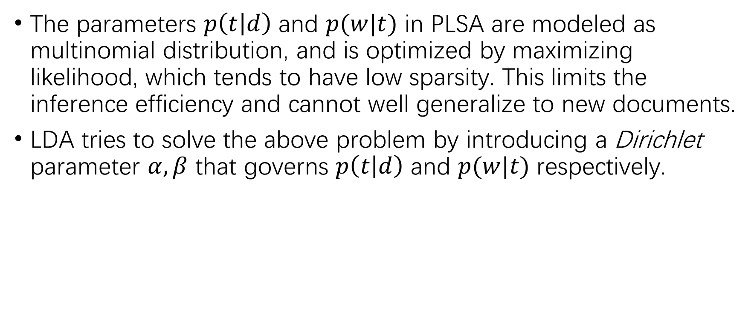
LDA
The parameters $p\left(t | d\right)$ and $p(w|t)$ in PLSA are modeled as multinomial distribution, and is optimized by maximizing likelihood, which tends to have low sparsity. This limits the inference efficiency and cannot well generalize to new documents.
LDA tries to solve the above problem by introducing a Dirichlet parameter $α,β$ that governs $p\left(t | d\right)$ and $p(w|t)$ respectively.

